Slide 1
‘Law’ ‘Order’ ‘Justice’ ‘Crime’: Disrupting key concepts through the study of colonial history
J M Moore
@Moore_J_M
j.m.moore@Herts.ac.uk

Slide 2
The Module
CRU608: Crime, Punishment and Justice in the British Empire
Delivered at Newman University, Birmingham
Drew on my research
Final year (level 6) 20 Credit Module on the BA Criminology Programme
Semester One (12 Weeks)
Weekly 3 Hour Workshop

Slide 3
The Students
Option Module
chosen by thirteen Students (From cohort of 27)
Working Class Commuter Students
Majority Non-White
All (bar one) first in their family to go to university

Slide 4
Why?
Use history of the British empire to critique key criminological concepts
Explore the Impact of Racism and “Race” on criminal justice thinking
Highlight the significance of the State and how criminal law is deployed as a governance strategy (With particular relevance on ‘Emergencies’ & exceptionalism
Provide a relevant curriculum for all students

Slide 5
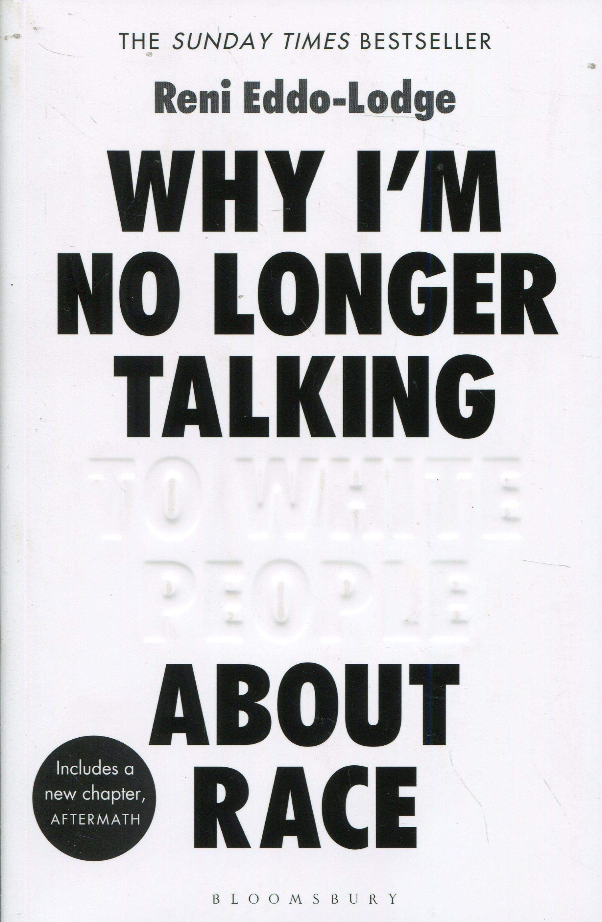
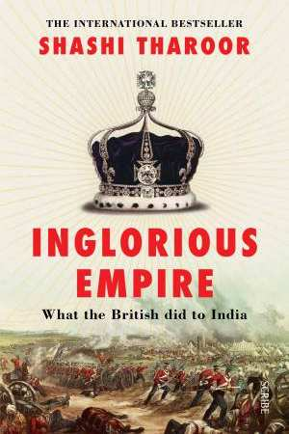
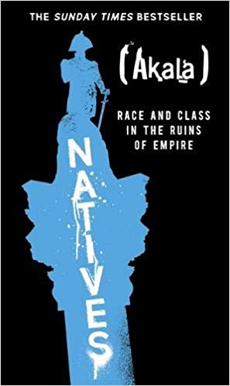
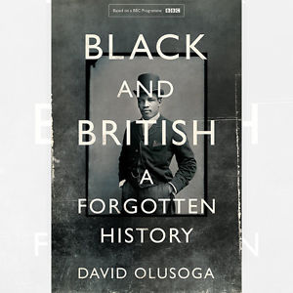
Pedagogy
Critical Pedagogy – Centring of Student experience
Learning Together – No Lectures/PowerPoints
  Set Readings
  Discussions
  Valuing experience
Visit to Liverpool

Slide 6
Pedagogy
Critical Pedagogy – Centring of Student experience
Learning Together – No Lectures/PowerPoints
  Set Readings
  Discussions
  Valuing experience
Visit to Liverpool

Slide 7
Curriculum
Concepts
  Crime
  ‘Race’
Visit to Slavery Museum (Liverpool)
Individual Tutorials x 2
Presentations
Case Studies
  Not a crime: the Atlantic Slave Trade
  Robbery with Violence: The Mugging of India
  Genocide: Australian Settler Colonialism
  (Dis)Order & (IN)Justice I – Morant Bay
  (Dis)Order & (IN)Justice iI – Kenya

Slide 8
Assessment
Essay (3,000 words)
Presentation (10 Minutes)
  Both on same question
Essay/Presentation Questions:
  Critically evaluate the role of ‘race’ in the criminal justice system of a British colony
  Critically evaluate the concept of ‘crime’ in the context of the history of the British empire.

Slide 9
Students Experiences I
We had to define crime
I didn’t appreciate the extent of the British Empire
At school you get taught about what happened in Germany, but they never tell you about our empire
History at school never went this far back
It was good to get more of an understanding, what happened, why it wasn’t criminalised, and why we still, even now, don’t take responsibility.
It made me think differently about crime and human rights
Criminology theories can’t explain the British empire

Slide 10
Students Experiences Ii
It made me think - why are there no criminological theories from colonised countries?
Talking to other members of the class, we were just so oblivious of our own history
My family comes from Pakistan, but I never understood its history. Now I understand the rivalry between India and Pakistan
I gave my Grandma the chapter on the looting of India. She didn’t believe me – so I gave her the chapter and said ‘read this – it did happen’.

Slide 11
Students Experiences Iii
Looking through books is boring, I prefer PowerPoints
I prefer being taught
The essay was really hard, we really had to work
It wasn’t any use in other modules – their subjects were totally different
It helped me understanding myself, the privilege and power it gives me
I see my brother getting stopped and searched different now

Slide 12
Evaluation (Briefly)
The history of the British empire is a good tool For critiquing key criminological concepts.
Students’ understanding of Racism Became much more focused on the structural.
The exceptionalism of ‘emergencies’ was an effective way of highlighting state power and the limitations of liberal concepts of justice.
all students found the curriculum relevant and reported that it helped them (in different ways and to different extents) understand themselves
Would it be better to dismantle this module and insert elements throughout the programme’s curriculum?

